Slide 1
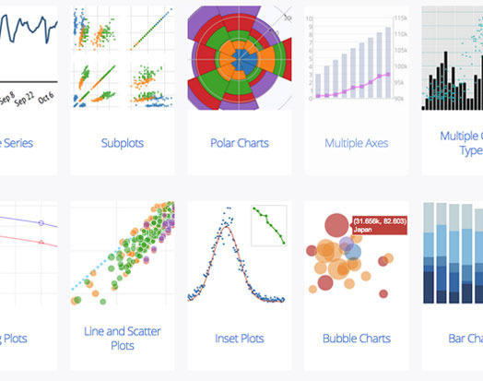
Outline
Useful libraries in Python
Matplotlib
Seaborn
Scikit-learn
Practice example – Iris dataset
Other visualization functions
Bokeh
Holoviews

Slide 2
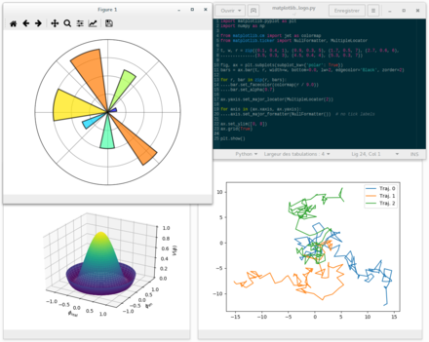
Matplotlib
Python plotting library first released in 2003
Produce publication quality figures
Work under interactive environments

Slide 3
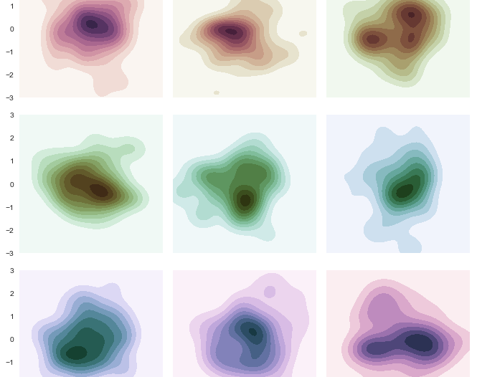
Seaborn
Built on Matplotlib
Appealing default aesthetics and color schemes
Extension of Matplotlib
Visualize many features at once

Slide 4

Scikit-learn
Machine learning library
Features various libraries

Slide 5
4 Steps for Creating Plots
Prepare data
Create plot
Customize plot
Save and show plot

Slide 6
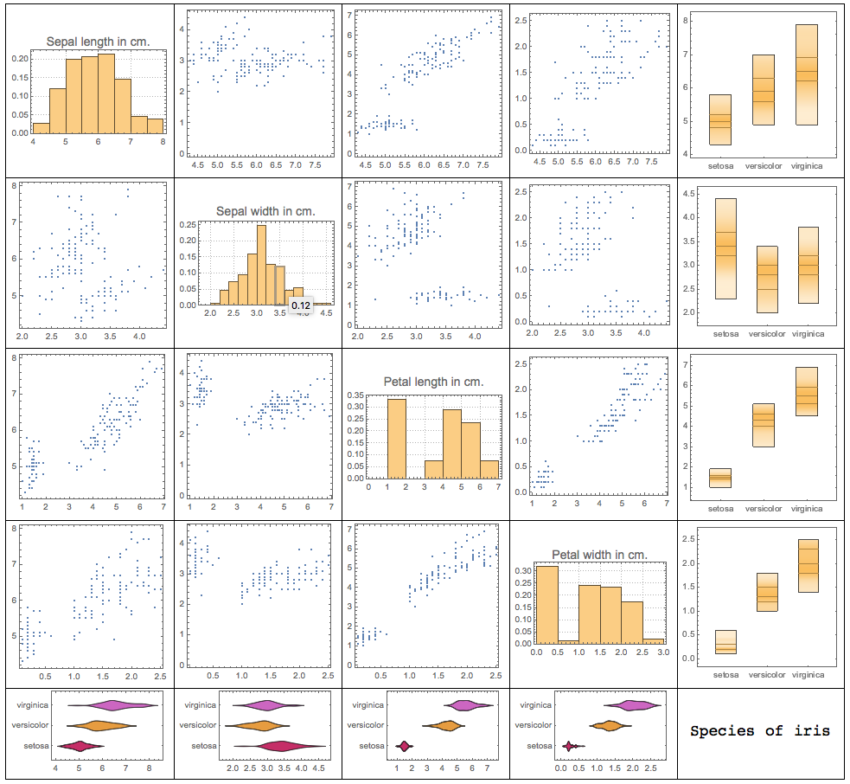
Example – Iris
Seaborn
Pandas
Matplotlib & Schikit-learn

Slide 7
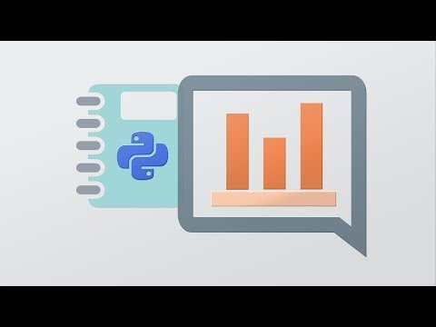
Other libraries
Bokeh
Holoviews

